Slide 1
•
COURSE POSITION 4 OF 14
Access Control & System Security
Users, Groups, and Permissions
System identities, reading long listing triplets, symbolic and octal chmod modes, creation umasks, and safe permission workflows.
2–3 Hours Duration
POSIX Discretionary Access
Workspace: ~/linux-course/lesson4

Slide 2
Course Objectives
Learning Goals & Lab Safety Boundaries
Identity & Triplets
Symbolic & Octal Modes
Lab Scope & No Sudo
Distinguish usernames from UIDs and decode the owner, group, and other triplets.
Apply least-privilege permissions using both and numeric modes like .
Work strictly in . Zero or ownership changes on host.
640
chmod u+x
sudo
~/linux-course/lesson4

Slide 3
Identity Architecture
User and Group Identity Models
Account Database: /etc/passwd
NUMERIC IDENTIFIERS
Stores username, UID, primary GID, home directory path, and login shell.
Names for Humans, IDs for the Kernel
People recognize usernames () and group names (), but the Linux kernel enforces all security decisions using numeric integers: UID and GID.
Group Database: /etc/group
Maps group names to numeric GIDs and lists member user accounts.
The superuser root is always assigned UID 0. Regular user accounts typically start at UID 1000 on Ubuntu systems.
Shadow Database: /etc/shadow
Stores password hashes and aging data with highly restricted read permissions.
developers
student

Slide 4
Identity Discovery
Inspecting Identity: id and groups
Primary vs. Supplementary Groups
# Inspect current session identity
$ id
Every user has exactly one primary group (assigned to newly created files by default) and zero or more supplementary groups.
uid=1000(student) gid=1000(student)
groups=1000(student),4(adm),27(sudo)
Group membership alone grants no permissions unless the file or directory's permission bits explicitly allow group access.
# Breakdown of fields
uid=1000: Current user ID
→ Prints list of group names for current user
gid=1000: Primary group ID
groups=...: All active memberships
groups

Slide 5
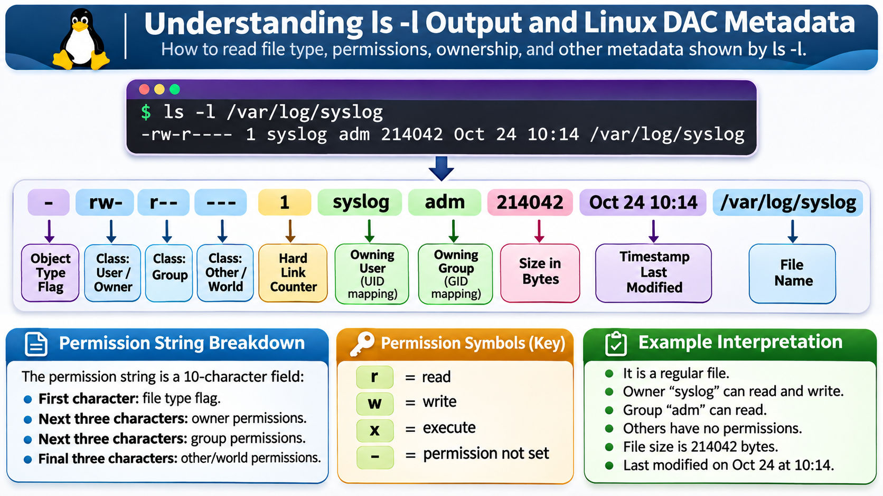
Permission Structure
Decoding the 10-Character Listing Mode
Type
-
Owner (u)
rw-
Group (g)
r--
Other (o)
---
Regular File
Read & Write (6)
Read Only (4)
No Access (0)
Owner Class (User)
Owning Group Class
Others Class (World)
Permissions for the single account that owns the file.
Permissions for all user accounts belonging to the owning group.
Permissions for everyone else who is neither owner nor group member.

Slide 6
Semantics Comparison
Read, Write, & Execute: Files vs. Directories
Ordinary Files
Directories
Read (r): List filenames contained inside (e.g., ).
Read (r): Open and view contents (e.g., , ).
ls
cat
less
Write (w): Modify, overwrite, or append file content.
Write (w): Create, rename, or delete entries inside directory.
Execute (x): Traversal / Search. Pass through via or access metadata.
Execute (x): Run the file as a program or binary executable.
cd
Text notes normally do not require execute permissions.
Accessing a file requires traversal (x) on every directory in its path!

Slide 7
Modifying Mode Bits
Symbolic Mode Notation: chmod
1. WHO (Class)
2. ACTION (Op)
3. WHAT (Bits)
Target Class
Operator
Permission
u
: User / Owner
+
: Add permission
r
: Read
g
: Owning Group
-
: Remove permission
w
: Write
o
: Others / World
: Set exact permission (clearing unspecified)
x
: Execute
a
: All classes (u+g+o)
=
chmod u+x script.sh
chmod g-w notes.txt
chmod o= private.txt
Examples: (adds user exec)
(removes group write)
(clears other access)

Slide 8
Numeric Modes
Octal Mode Notation (4-2-1 Value Sums)
Binary Bit Weights
chmod 640 notes.txt
Each permission triplet is represented as a 3-bit binary octal digit from 0 to 7:
6 (rw-) for Owner, 4 (r--) for Group, 0 (---) for Others.
Standard confidential team document mode.
r (Read) = 4
w (Write) = 2
x (Execute) = 1
chmod 750 lab-script.sh
7 = 4+2+1 (rwx) | 6 = 4+2 (rw-) | 5 = 4+1 (r-x)
7 (rwx) for Owner, 5 (r-x) for Group, 0 (---) for Others.
Standard executable team script mode.

Slide 9
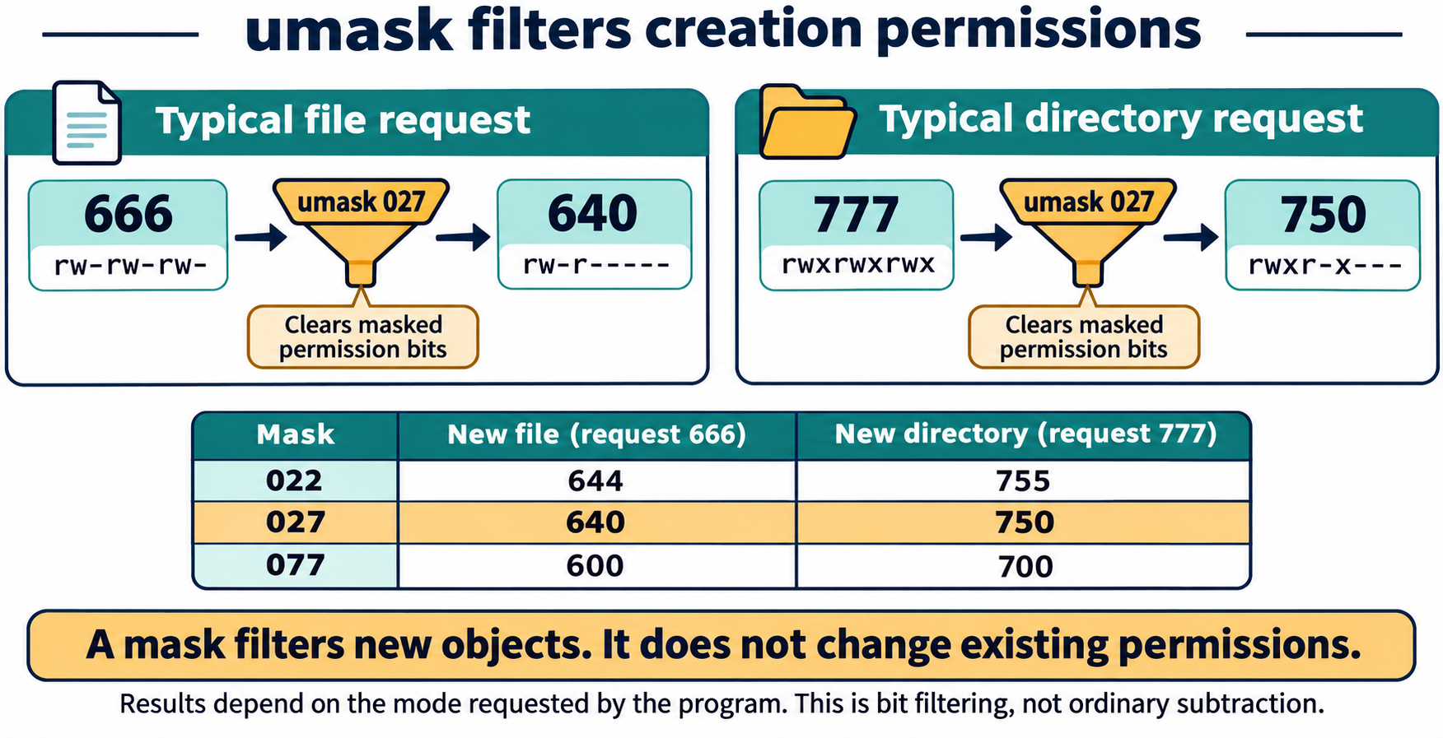
Default Creation Mask
umask: The Creation Filter Bitmask
A FILTER, NOT SUBTRACTION
Standard Mask 022
Mask Clears Requested Bits
Files → 644 (rw-r--r--) | Dirs → 755 (rwxr-xr-x)
When an application creates an object, it requests a base mode (typically 666 for files, 777 for directories).
Tightened Mask 027 (Figure 4.3)
Files → 640 (rw-r-----) | Dirs → 750 (rwxr-x---)
The process bitwise-clears specific permission bits before writing to disk.
umask
Private Mask 077
Existing files are completely unaffected by umask changes.
Files → 600 (rw-------) | Dirs → 700 (rwx------)

Slide 10
Ownership Control
Owner and Group vs. Permission Bits
chown (Change Owner)
chgrp (Change Group)
Assigns User & Group
Changes Group Only
Changes file owner and optionally group ownership:
Modifies the owning group assignment of an object:
sudo chown student:developers file.txt
sudo chgrp developers file.txt
Requires administrative privileges on Ubuntu. Excluded from student lab.
Careless ownership changes can instantly make files inaccessible or expose private data.

Slide 11
Advanced Access Control
Special Permission Bits & POSIX ACLs
SUID (SetUID)
SGID / Sticky
getfacl & setfacl
Run as File Owner
Shared & Protected
Access Control Lists
s
+
passwd
ls -l
t
/tmp
Sticky ( on ) ensures only file owners or root can delete files in a shared directory.
Grants permissions to named users beyond basic triplets. Displayed with a trailing in .
Displays as in owner field. Process executes with owner rights (e.g., ).
Recognition Only: Special bits and ACL administration are instructor demonstration topics, not student lab commands.

Slide 12
Administrative Context
Account Administration in a Disposable VM
DISPOSABLE VM ONLY
Administrative Safeguards
Account creation, group alterations, and ACL changes require elevated root access and are performed exclusively by the instructor in an isolated VM.
# 1. Create temporary group & user
sudo groupadd lesson4-demo
-a
sudo useradd -m -s /bin/bash lesson4-student
usermod -aG
-a
Caution on : The (append) flag is critical. Omitting replaces all existing supplementary groups!
# 2. Append supplementary group
sudo usermod -aG lesson4-demo lesson4-student
# 3. Modify ACL entry
sudo setfacl -m u:lesson4-student:r shared.txt
getfacl shared.txt

Slide 13
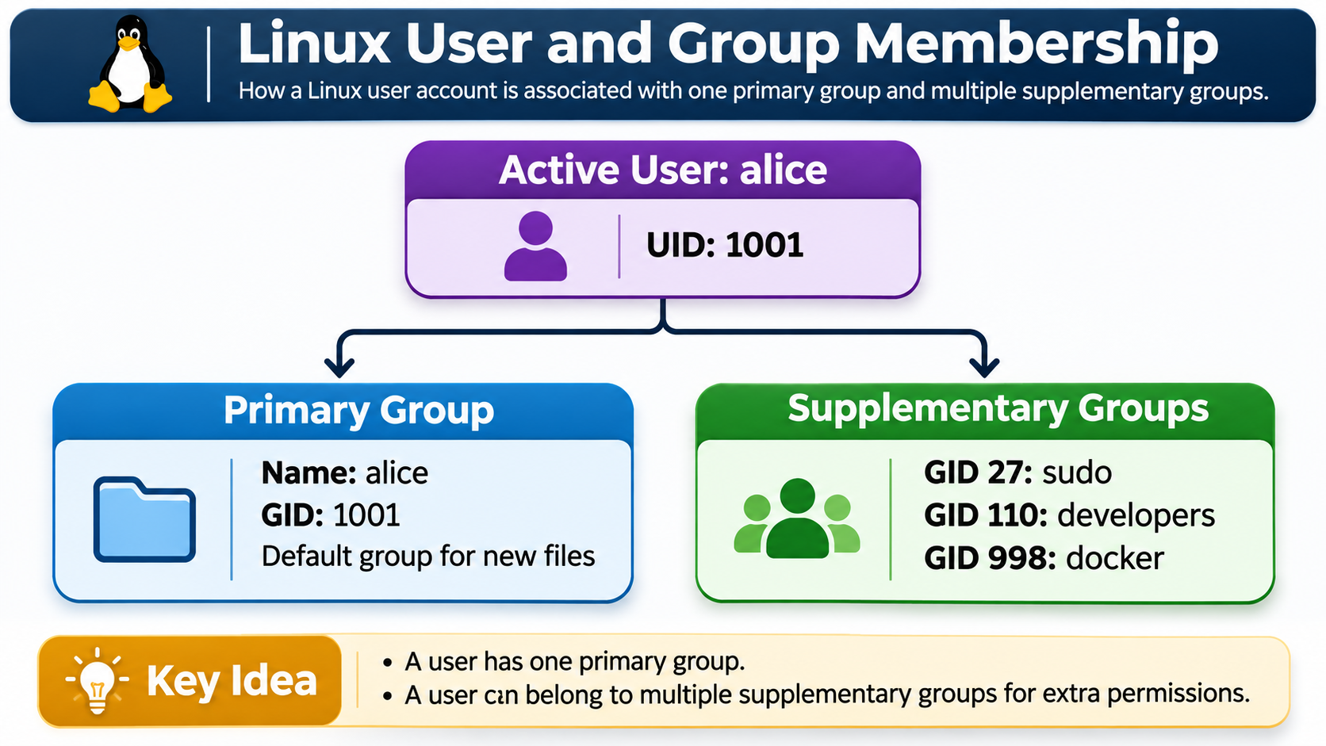
Operational Discipline
The Least-Privilege Permission Workflow
PHASE 01
PHASE 02
PHASE 03
PHASE 04
Identify Target
Assess Need
Targeted Change
Verify Listing
Run precise on specific file. Avoid .
Re-run to confirm exact triplet alteration.
Run to inspect owner, group, and active mode.
Ask who needs access and what smallest access suffices.
ls -l
-R
chmod
ls -l

Slide 14
Hands-On Practice
Student Lab: 6-Part Workflow
PART A
PART B
PART C
PART D
PART E
PART F
Inspect ID
Practice Area
Symbolic
Octal Mode
umask Filter
Review VM
Run & to view UID/GID.
Create & .
Apply on script & on note.
Set mode and mode .
Inspect default file and directory creation.
Evaluate , , and ACL output.
id
groups
private.txt
u+x
640
chown
lab-script.sh
o-r
750
chgrp

Slide 15
LESSON 4 REVIEW
Key Concepts & Exit Ticket
"For directories, execute permission actually means ______, and changing permissions with chmod 640 grants ______ to owner, ______ to group, and ______ to others."
Symbolic & Octal chmod
umask creation filter
Next: Lesson 5 (Processes & Job Control)

